Slide 1

Real-time Equity Analysis: Empowering Sustainable Investing

Slide 2

Project Overview
1
Real-time Data
2
ESG Integration
3
Sentiment Analysis
Our platform fetches live stock information from Alpha Vantage API. It provides up-to-the-minute price, volume, and trading data.
We incorporate environmental, social, and governance factors into our analysis. This gives a holistic view of a company's sustainability performance.
Our tool analyses social media and news platforms. It gauges market sentiment to provide a comprehensive investment perspective.

Slide 3

Technical Architecture
1
Frontend
Built with HTML, CSS, and JavaScript. It provides an intuitive interface for users to interact with the data.
2
Backend
Powered by Node.js and Express.js. It handles API requests and data processing efficiently.
3
Data Sources
Integrates Alpha Vantage API for stock data. Uses web scraping for ESG information and sentiment analysis.

Slide 4






Setting Up the Project
Clone Repository
Use Git to clone the project repository to your local machine.
Install Dependencies
Run 'npm install' to set up all necessary Node.js packages.
Configure API Key
Add your Alpha Vantage API key to the .env file.
Launch Application
Start the server with 'node server.js' and open index.html in your browser.

Slide 5
Key Features
Real-time Stock Data
ESG Metrics
Sentiment Indicators
Access live price, volume, open, and close data. View intraday, daily, weekly, and monthly timeframes.
Comprehensive sustainability scores. Breakdowns of environmental, social, and governance performance for each company.
Real-time analysis of social media trends. Integration of latest news sentiment for informed decision-making.

Slide 6
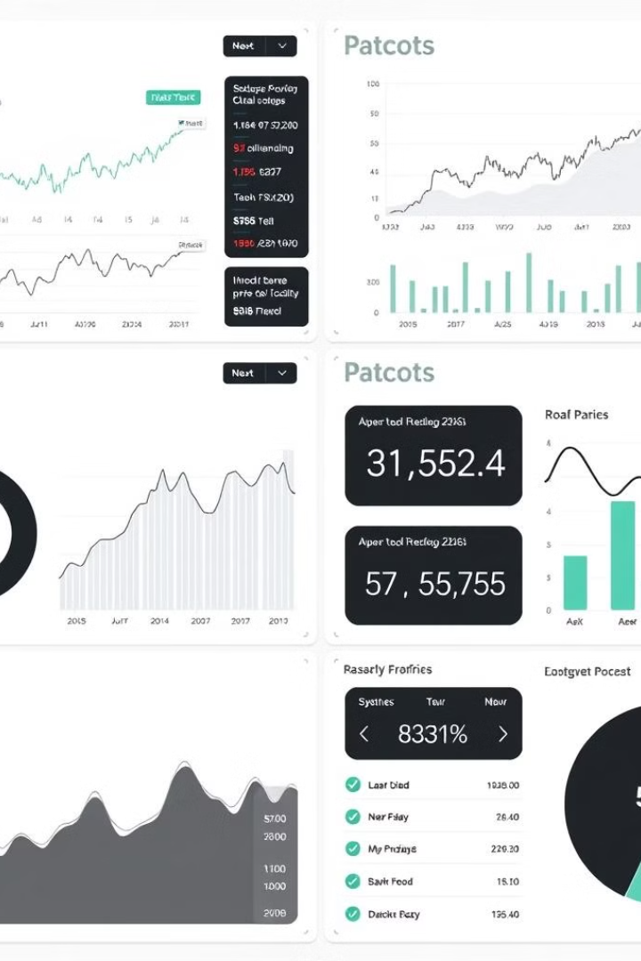



Data Visualization
Interactive Charts
Customizable stock price charts with multiple technical indicators.
ESG Gauges
Easy-to-read gauges displaying sustainability scores for quick assessment.
Sentiment Heatmaps
Visual representation of market sentiment across different sectors.

Slide 7

Future Enhancements
Machine Learning Integration
Implement AI algorithms for predictive analysis. Enhance accuracy of sentiment analysis and stock predictions.
Blockchain Integration
Explore decentralized finance (DeFi) opportunities. Implement smart contracts for automated trading strategies.
Mobile App Development
Create native mobile applications for iOS and Android. Provide on-the-go access to real-time equity analysis.

Slide 8


Get Involved
Contribute Code
Fork the repository and submit pull requests
Report Issues
Use GitHub Issues to report bugs or suggest features
Join Discussions
Participate in our community forums for ideas and support

